Slide 1
Super Resolution using GAN

Slide 2
Super Resolution – why?
Generating high resolution image with more resolving power using one or more low resolution images.
more resolving power – more details
Surveillance: For instance, to guarantee the long-term stable operation of the recording devices, as well as the appropriate frame rate for dynamic scenes, digital surveillance products tend to sacrifice resolution to some degree.
remote sensing field: there is always a tradeoff between the spa- tial, spectral, and temporal resolutions.
As for medical imaging, within each imaging modality, specific physical laws are in control, defining the meaning of noise and the sensitivity of the imaging process.

Slide 3
Super Resolution Methods
Multi image super resolution
Example based super resolution

Slide 4
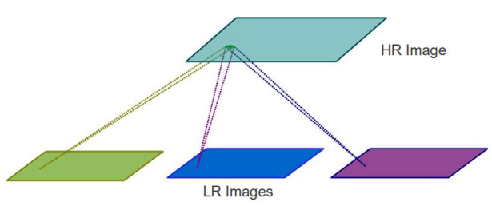
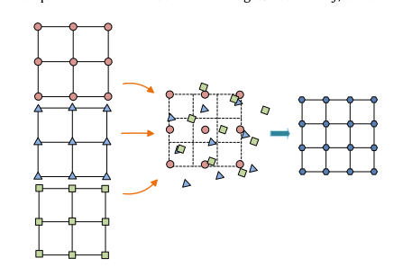
Multi Image Super Resolution
Several images of the same scenery.
Each image will have different information of the same scenery
Source

Slide 5
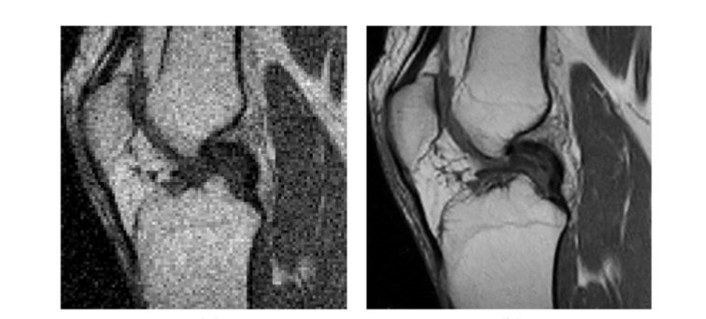
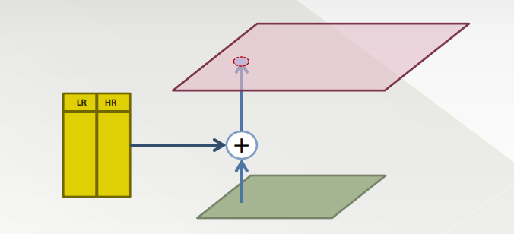
Example Based Super Resolution
Image database with HR/LR image pairs
Replace similar LR patches with corresponding HR patches
Usually scale based on single image, thus called single image super resolution (SISR)

Slide 6
Super Resolution using GANs
As you can imagine – GAN is excellent for this task
The basic idea is that the generator network will take LR images, and output HR images
Generator tries to use a generated HR images to fool discriminator
Discriminator will learn from both the original HR images and the generated HR images
After the training process, the discriminator cannot distinguish between the generated HR image and the original image, then the generator learns how to fool the discriminator
We then give the generator a new input that it has never seen. It will produce the HR image for us

Slide 7
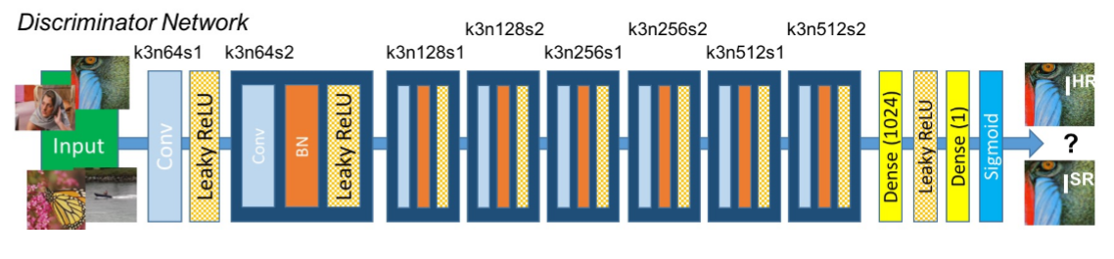
Tricks there
GAN is very hard to converge and is very unstable during training
One of the trick here is that use some pre-trained model to initialize the network weights of discriminator network

Slide 8
More on Super Resolution
Tutorials are available in CNTK
Go search for “CNTK Super resolution”, you will find it in CNTK doc site
4 models available, and the GAN one (SRGAN) performs best
Available in 2 notebooks:
1. pre-trained models (here)
2. script to guide you to train from scratch (here)

Slide 9
Limitations
One of the important aspect of example-based image super resolution is that it needs to be trained on similar “example” dataset.
For example, if you want to do super resolution on MRI medical images for knees, you must train it on other MRI images (such as for arms)
Training with Chest X-ray images won’t help
Training with cartoons, movies, celebrity faces won’t help

Slide 10
Interesting use caes

Slide 11
Making a machine imitate Humans

Slide 12
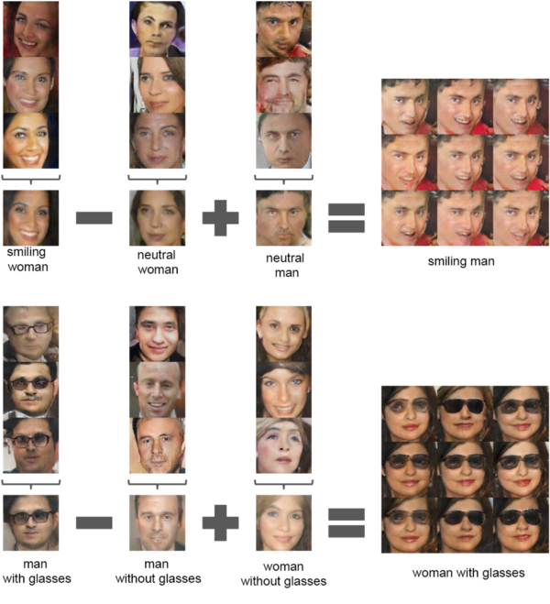
Changing Facial Expressions & Features in Photos

Slide 13
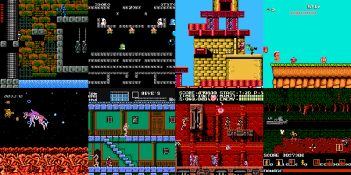
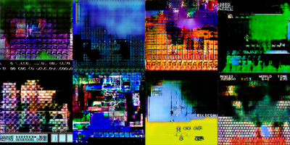
Game UI design using GANs
Left — Game background images given as input. Middle — Background images are generated as GANs gets better and better. Right — Unique game tile sheets that can be used for new game creation

Slide 14
Turning horses into zebras
Animal transfiguration — Converting an Image of horse to an Image of Zebra by detecting the moving horse in the video and superimposing zebra stripes on top of it.

